Slide 1
CSE421: COMPUTER GRAPHICS WEILER-ATHERTON POLYGON CLIPPING ALGORITHM
MAHIMUL ISLAM NADIM
LECTURER
DEPARTMENT OF CSE
DAFFODIL INTERNATIONAL UNIVERSITY

Slide 2
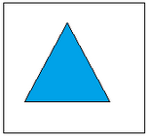
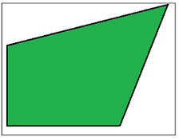
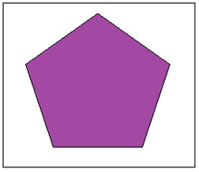
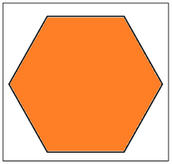
POLYGON
A Polygon can be described as the collection or group of closed lines.
All lines are connected.
Some Examples of the polygon:
Triangles
Pentagons
Hexagons

Slide 3
POLYGON CLIPPING
Polygon clipping is a process in which we only consider the part which is inside the view pane or window.
We will remove or clip the part that is outside the window.
We can use the following algorithms for polygon clipping–
Sutherland-Hodgeman polygon clipping algorithm
Weiler-Atherton polygon clipping algorithm

Slide 4
WEILER-ATHERTON POLYGON CLIPPING ALGORITHM
Clip polygon point
Subject polygon point
Intersection point

Slide 5
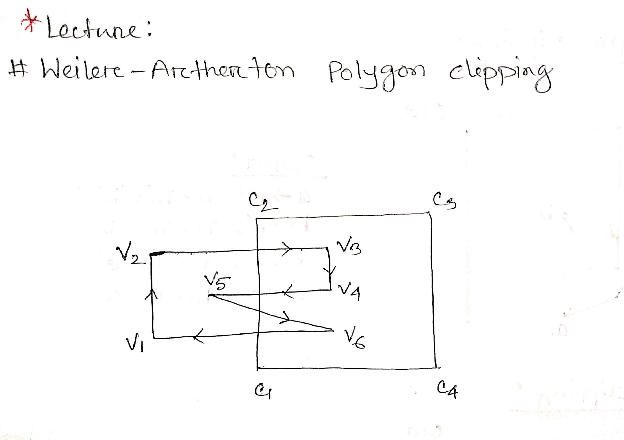

Slide 6
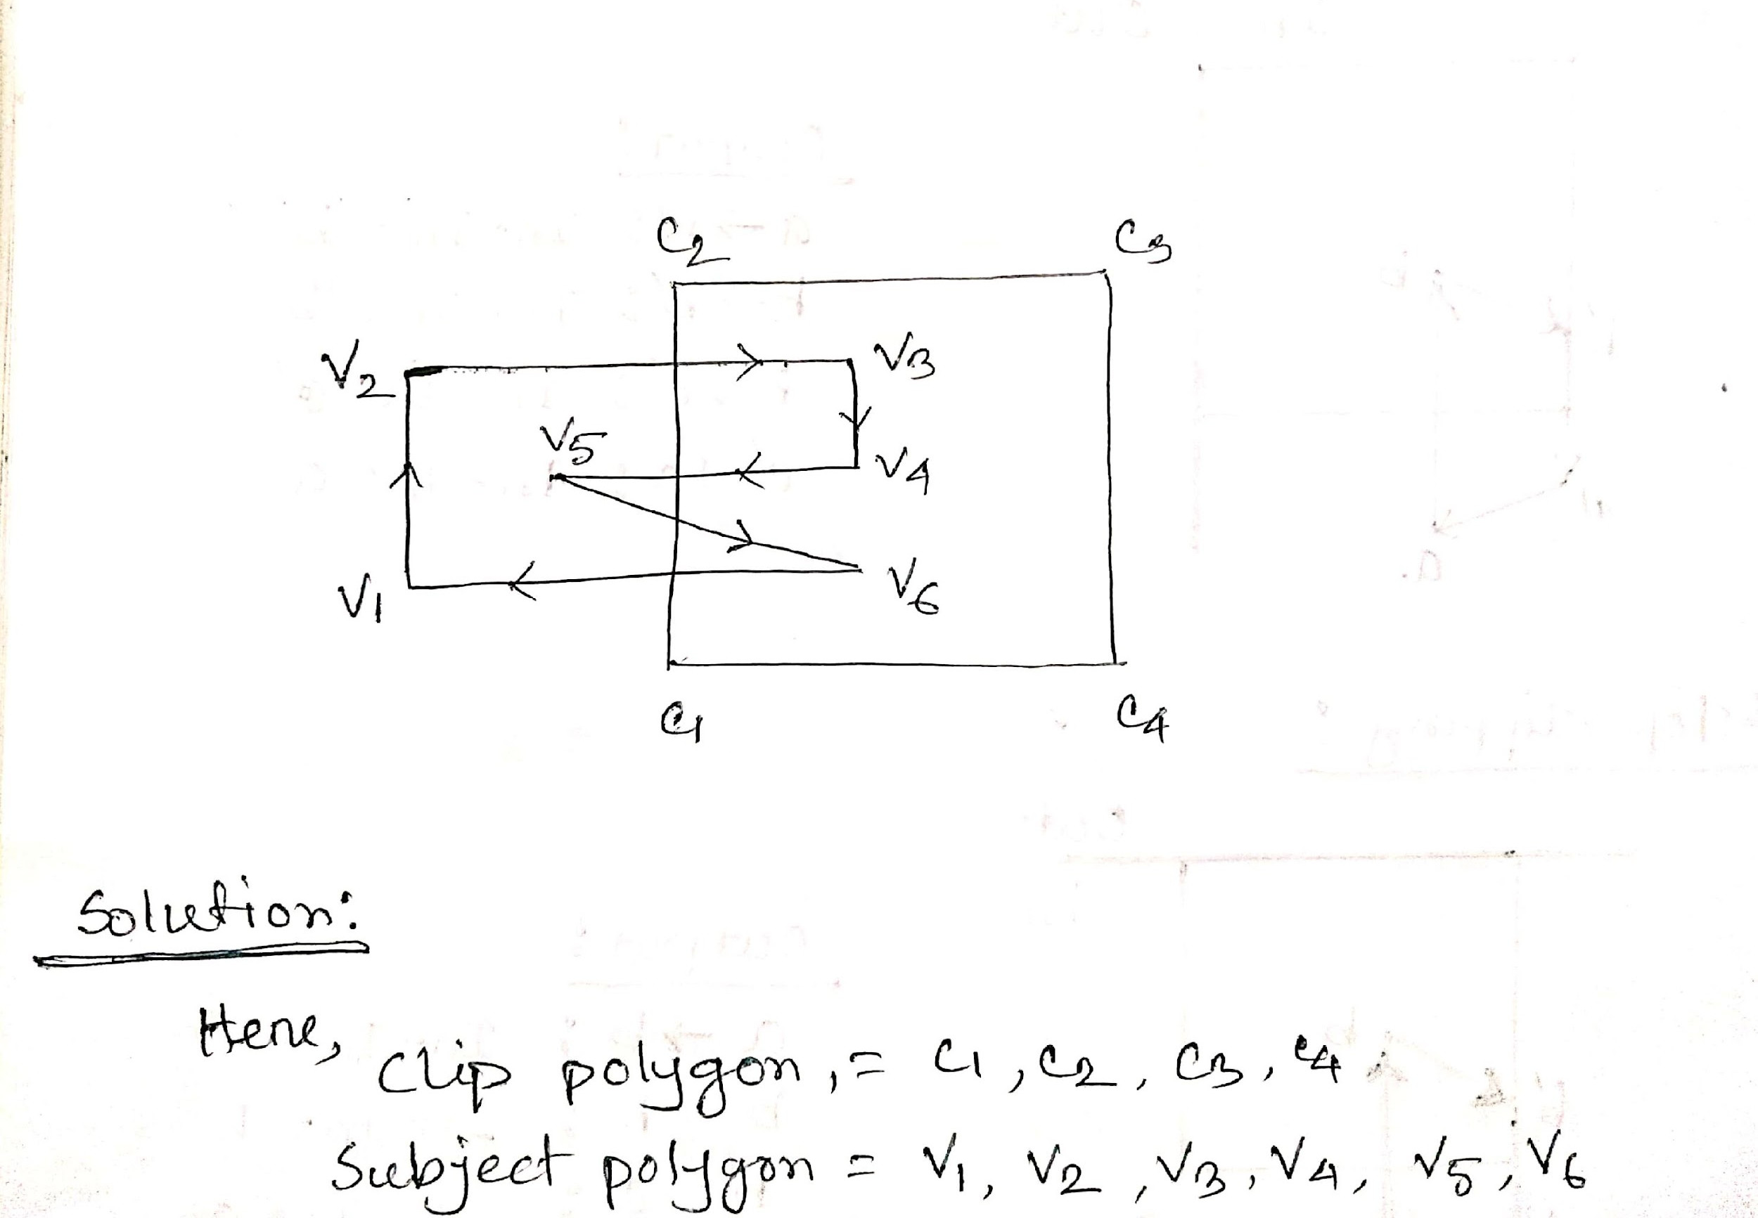

Slide 7
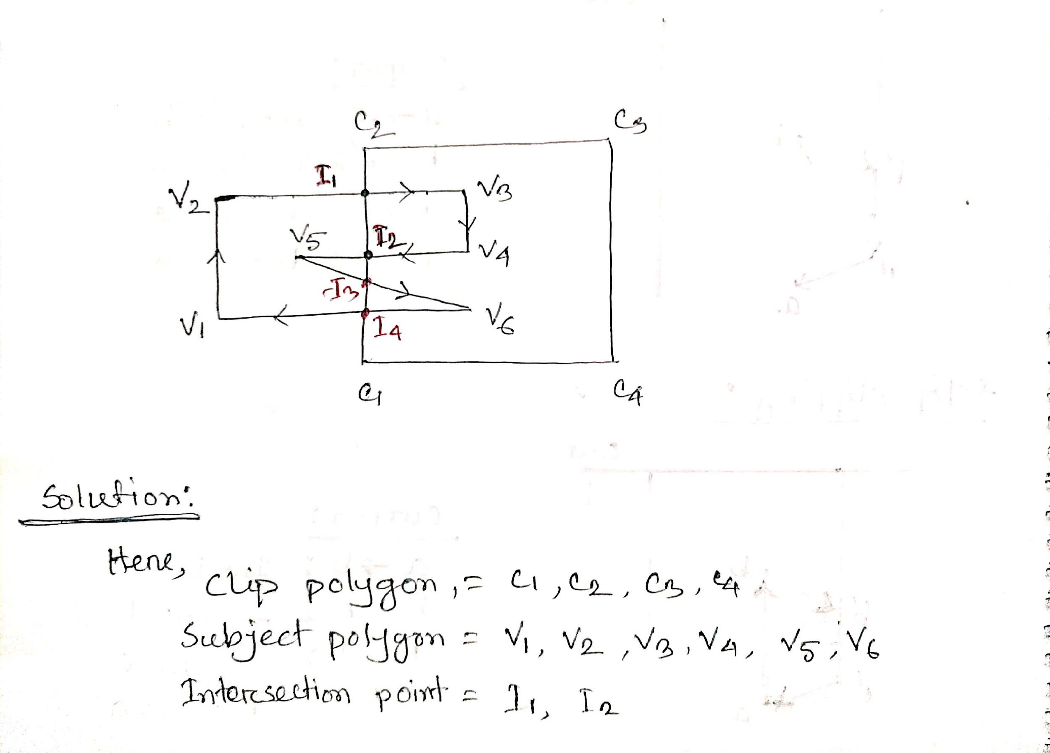

Slide 8
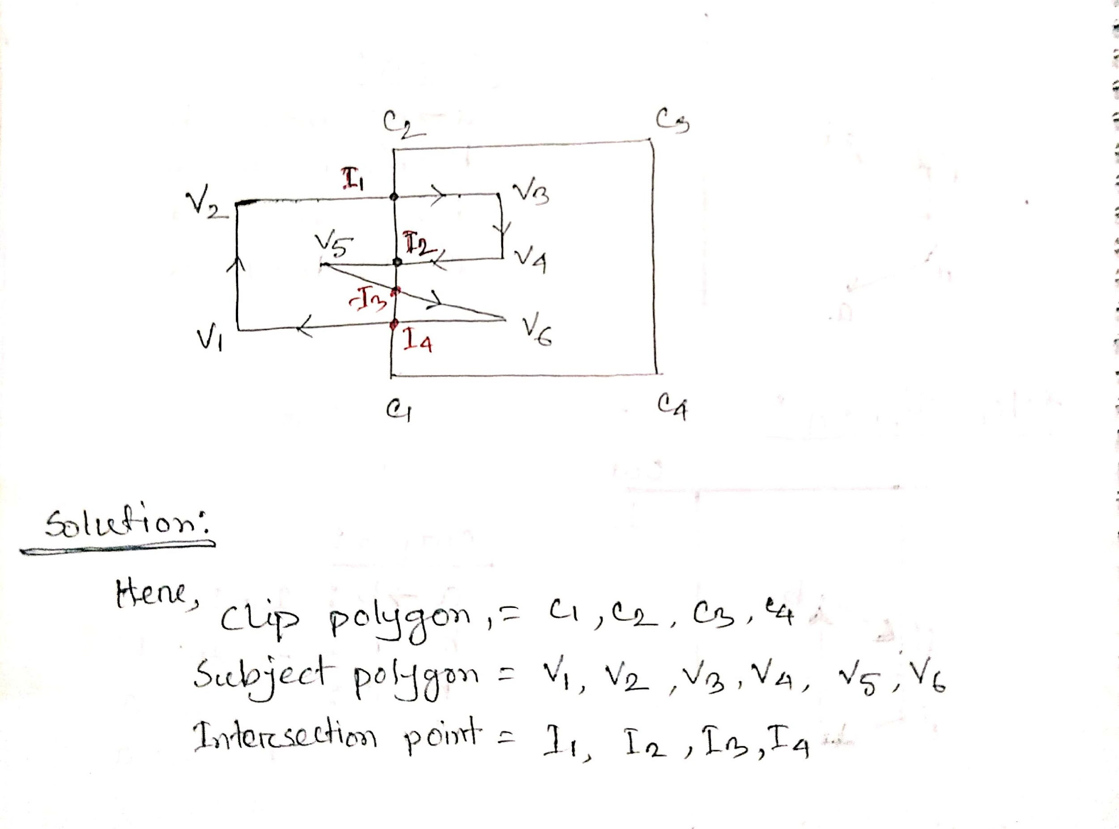

Slide 9
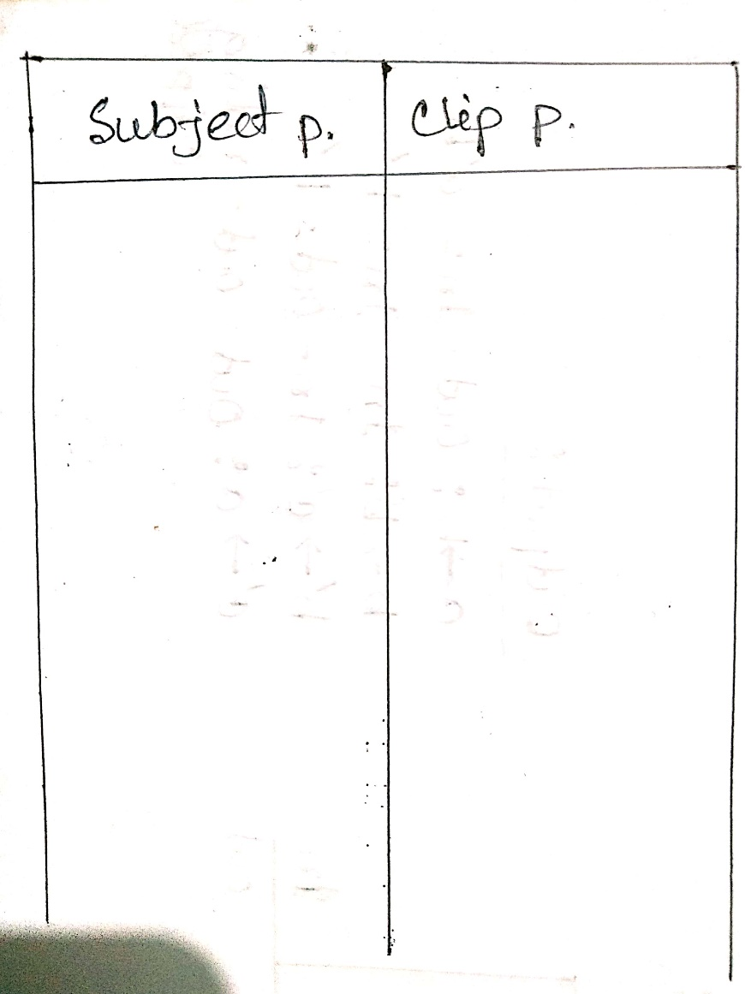

Slide 10
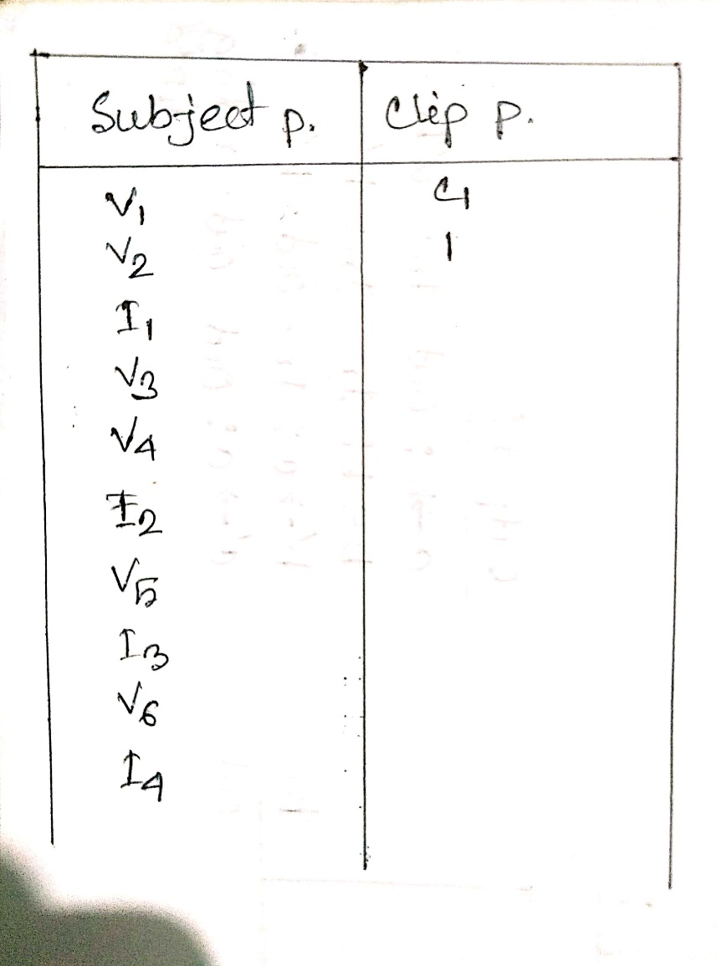

Slide 11
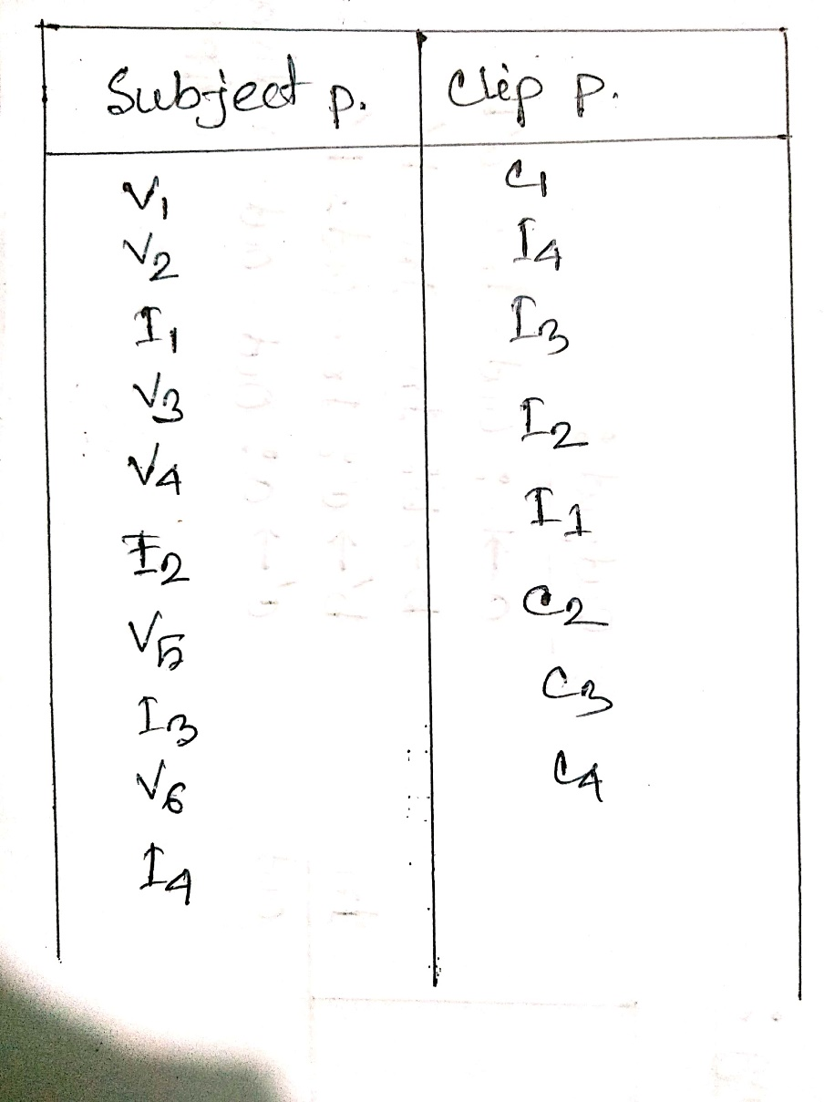

Slide 12
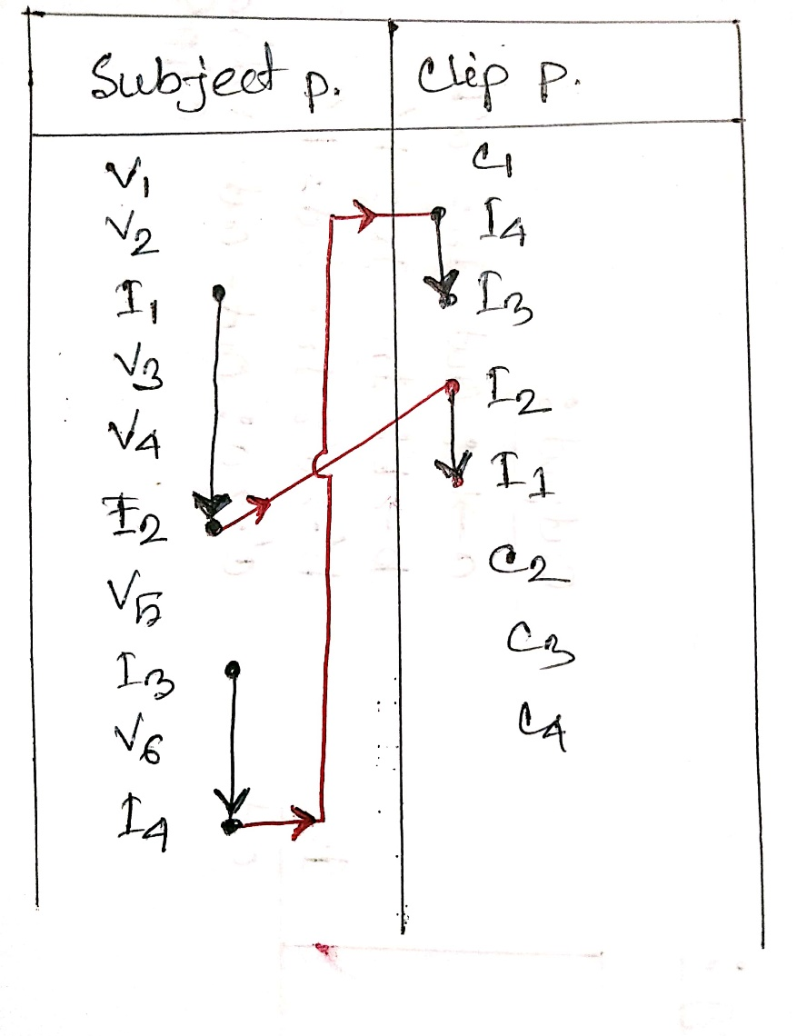

Slide 14
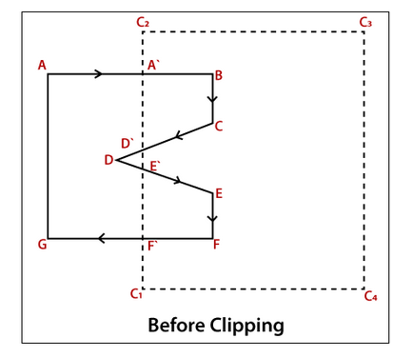

Slide 15
Thank You…

